Slide 1
ES 200: Autumn 2020
Environmental Studies : Science and Engineering
Module C: Solid Waste Management
Prof. Tabish Nawaz (Module C)
(tnawaz@iitb.ac.in)
Environmental Science and Engineering Dept.,
IIT Bombay
* Instructor In-Charge
(vsethi@iitb.ac.in)

Slide 2

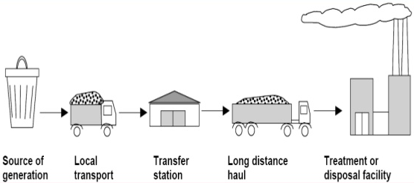
Module C
Solid Waste Management
Lecture-4 Topics
MSW Transfer and Transport
Transfer Stations
MSW Processing Techniques
Primary Processing

Slide 3
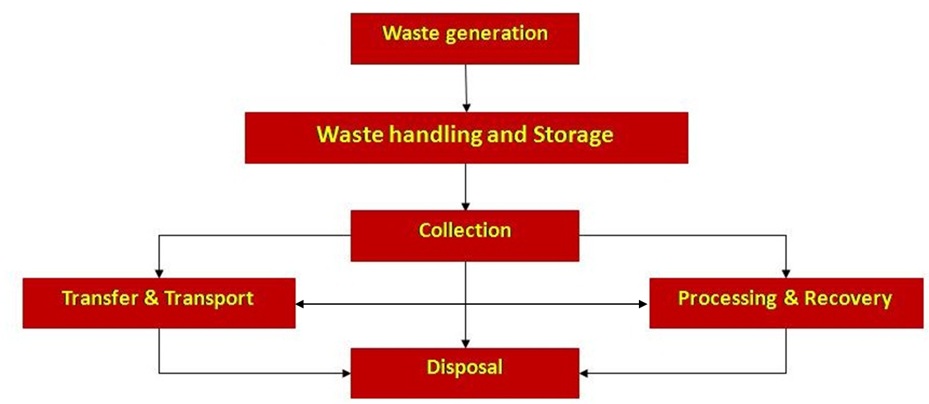
Functional elements of a solid waste management system

Slide 4
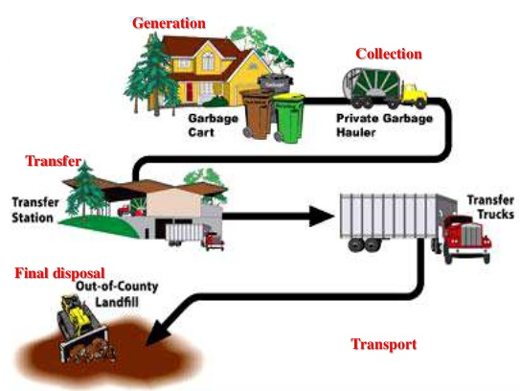
Transfer and Transport

Slide 5
MSW Transfer Stations
As the distance from the collection system to the processing facility or disposal site (destination point) increases, the cost of hauling or transportation also increases.
There will eventually be a certain transport distance where the municipality must decide whether or not, a transfer station is to be built.
A transfer station is a facility where the waste collected may be stored temporarily or transferred from the smaller collection vehicles to bigger transport vehicle for transportation to the destination point.
There are 3 general types of transfer stations:
direct discharge
storage discharge
Combined direct and storage discharge

Slide 6
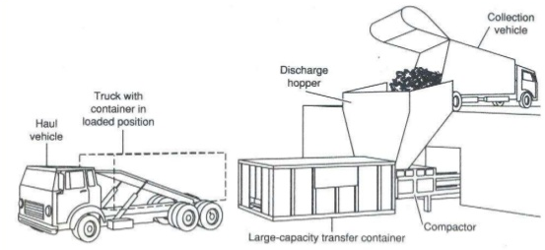
MSW Transfer Stations
Typical direct-discharge transfer station
For a direct discharge transfer station, collection vehicles dump their loads directly into the larger transportation vehicles.

Slide 7
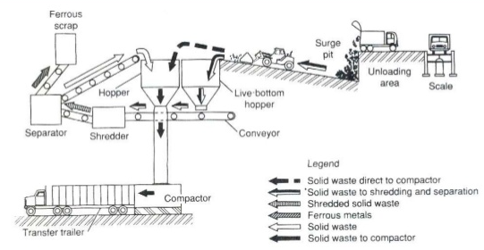
MSW Transfer Stations
Typical storage-discharge transfer station
In a storage transfer station, the solid wastes are emptied into the storage pits or platforms. The wastes are then later loaded into big transport vehicles for hauling to the destination point.

Slide 8
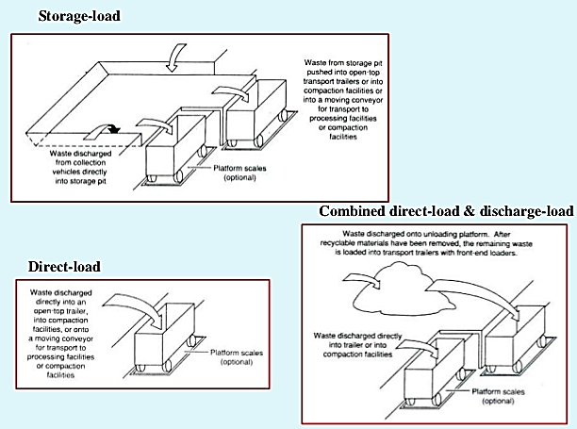
MSW Transfer Stations

Slide 9
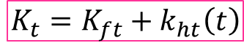
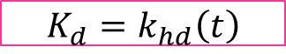
Economic Comparison of Alternatives
Break-even point analysis:
Let the cost of direct hauling to the destination point from the collection system be K_{d}, $/unit mass of MSW.
If the unit cost of this direct haul is k_{hd} $/unit mass of MSW per time ‘t’;
The cost involved when a transfer station is constructed are: operating costs, amortization cost, and hauling cost.
Let the sum of the unit costs of operating and amortization be K_{ft} $/unit mass of MSW.
The cost of hauling be k_{ht} $/unit mass of MSW per unit time.
If the hauling cost using a transfer station is K_{t} $/unit mass of MSW, then
$$K_{d}=k_{hd}\left(t\right)$$
Eq (1)
$$K_{t}={K_{ft}+k}_{ht}\left(t\right)$$
Eq (2)
Notes:
Amortization cost = Capital cost expressed over time
Amortization = process of paying off debts with regular debts over time

Slide 10

Economic Comparison of Alternatives
Break-even point analysis:
Since, using the transfer station will afford the operator the opportunity to utilize a larger transport vehicle, k_{ht} < k_{hd}
There will be length of haul time that the plot of equations (1) and (2) will intersect.
This point of intersection is called the break-even point.
Beyond this point, direct haul to the destination point is not economical, compared to when a transfer station is constructed.
Equating (1) and (2), the break even time can be calculated as :
An example problem of break-even point is shown in the next slide.
$$t_{even}=\frac{K_{ft}}{k_{hd}−k_{ht}}$$

Slide 11
Economic Comparison of Alternatives
Q) Determine the break-even haul time between a direct haul system and a
transfer station (TS) operation with the following properties:
Direct haul system uses a 10 yd³ container
Direct haul cost = $20/hr
The transfer trailer has a capacity of 100 yd³
Tractor-trailer haul cost = $40/hr
Also given that:
Function of amortized capital cost, capacity, operating costs
Cost $3,750,000 (for bldg, equipment, tractor/trailer)
Capacity of 300,000 yd³ per year
CRF is 0.08 (capital recovery factor is a function of interest rate and years to pay off – converts capital cost to $/yr), yr⁻¹
TS operating cost is $225,000/yr

Slide 12
Economic Comparison of Alternatives
Step 1: Calculate Capital Cost Elements (TS)
TS total cost/yd³ = annual capital cost + annual op cost
Amortize Capital cost: = $3,750,000 x 0.08 = $300,000/yr
Total annual costs: ($300,000 + $225,000) yr⁻¹ = $525,000/yr
Cost/yd³: ($525000/yr)/300,000 yd³/yr = $1.75/yd³
Step 2: Calculate Hauling Operating Cost
TS trailer haul operating cost = $40/hr/100 yd³ = $0.40/hr-yd³
Direct haul operating cost = $20/hr/10 yd³ = $2.00/ hr-yd³
Step 3: Equate Direct Haul Costs to Transfer Station Costs to Calculate the Break Even Haul Time (t_{even})
$2.00/hr-yd³ (t_{even}) = $1.75/yd³ + $0.40/hr-yd³ (t_{even})
t_{even} = 1.1 hours

Slide 13
Economic Comparison of Alternatives
Break-even point analysis:

Slide 14
Functional elements of a solid waste management system

Slide 15
MSW Processing and Recovery
Processing techniques are used in MSW management system to:
Improve the efficiency of MSW disposal systems
To recover resources (usable materials)
To prepare materials for the recovery of conversion products and energy
Processing techniques used routinely in MSW systems include:
Mechanical volume reduction (compaction)
Thermal volume reduction (incineration)
Manual separation of waste components
Notes:
Final compacted MSW has a constant density of about 1100 kg/m3 irrespective of initial density. MSW can be compressed up to 90% the initial state by thermal volume reduction.
Manual sorting at the source is the most positive way to achieve recovery and reuse of materials.

Slide 16
Factors to be considered in evaluating on-site MSW processing equipment
Factor | Evaluation
Capabilities | What will the device or mechanism do? Will its use be an improvement over conventional practices?
Reliability | Will the equipment perform its designated functions with little attention beyond preventive maintenance? Has the effectiveness of the equipment been demonstrated in use over a reasonable period of time or merely predicted?
Service | Will servicing capabilities beyond those of the local building maintenance staff be required occasionally? Are properly trained service personnel available through the equipment manufacturer or the local distributor?

Slide 17
Factors to be considered in evaluating on-site MSW processing equipment
Factor | Evaluation
Safety of operation | Is the proposed equipment reasonably fool proof so that it may be operated by tenants or building personnel with limited mechanical knowledge of abilities? Does is it have adequate safeguards to discourage careless use?
Ease of operation | Is the equipment easy to operate by a tenant or by building personnel? Unless functions and actual operation of equipment can be carried out easily they may be ignored or short-circuited
Efficiency | Does the equipment perform efficiently and with a minimum of attention? Under most conditions, equipment that completes an operation cycle each time it is used should be selected

Slide 18
Factors to be considered in evaluating on-site MSW processing equipment
Factor | Evaluation
Environmental effects | Does the equipment pollute or contaminate the environment?
Health hazards | Does the device/mechanism create or amplify health hazards?
Economics | What are the economics involved? Both first and annual costs, future operation and maintenance cost must be assessed. Equipment produced by well-established companies with proven track record should be given consideration

Slide 19
Preliminary Processing - Mechanical

Slide 20
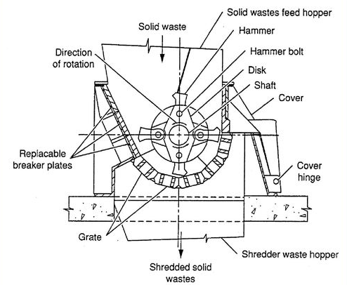
Mechanical Size Alteration
Function: To obtain a final product that is reasonably uniform and considerably reduced in size in comparison with its original form.
Size reduction does not necessarily imply volume reduction.
Equipment used includes:
Hammermill (shown in picture)
Shredders
Roll crushers
Grinders
Chippers
Jaw crushers
https://slideplayer.com/slide/13118867/

Slide 21
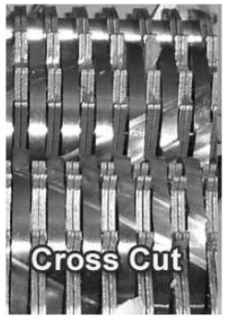
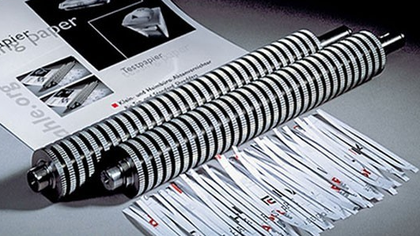
Mechanical Size Alteration
Shredding should be preceded by screening:
Shredders shatter glass and entrap organic materials within tin cans.
It contaminates paper with liquids and putrescible organic materials, and has high energy demand.
https://www.abcoffice.com/office-equipment-news/2011/01/cross-cut-vs-strip-cut-paper-shredders-on-a-mechanical-level/

Slide 22
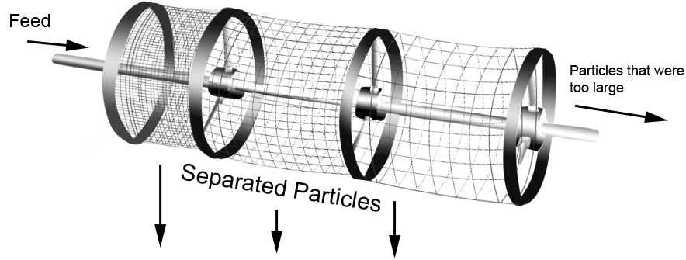
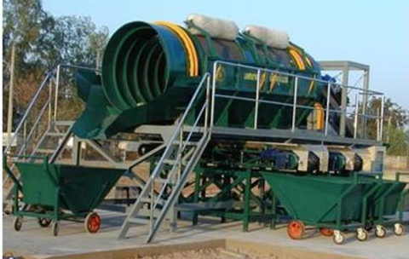
Mechanical Component Separation
Necessary operation in the recovery of resources from MSW, and where energy and conversion products are to be recovered.
Screening with trommels are used for separation of unprocessed wastes now, instead of shredders, as they protect shredder in RDF (refuse-derived fuel) production by removing oversized materials, and separating cardboard and paper.

Slide 23
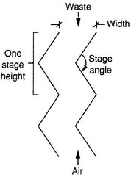
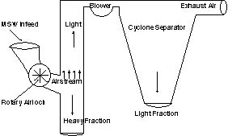
Air Separation
Can separate lighter materials (organics, paper products) from heavier (inorganic) ones, based on terminal settling velocity
Separate the light fraction of organic materials from the conveying air streams, done with cyclone separator.
cyclone separator

Slide 24
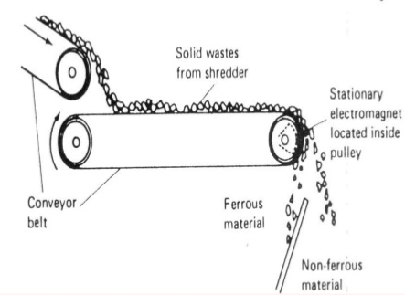
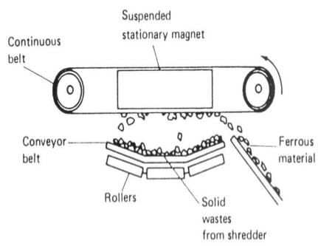
Magnetic and Electromechanical Separation
Magnetic separation of ferrous materials is now being used for removal of ferrous metals from MSW.
Electro-mechanical separation techniques for nonferrous materials.
Pulley-type and Suspended-type magnetic separators

Slide 25
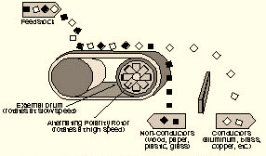
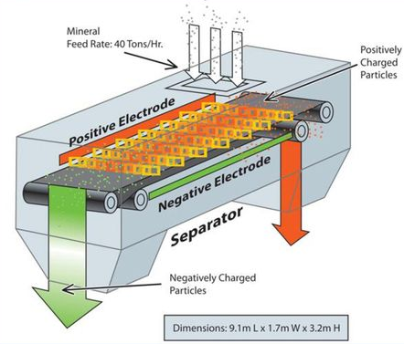
Eddy Current and Electrostatic Separation
Eddy current separation for aluminium and Electrostatic separation for glass in wastes free of ferrous and aluminium scrap.
Eddy current technology works by exerting repulsive forces on electrically conductive materials.
These systems should be located after magnetic separation to minimize contamination by ferrous materials.
Eddy Current Separator
Electrostatic Separator
Notes:
Eddy current separation makes ferrous materials very hot; hence it should be performed after magnetic separation to avoid damage
Non-conductors can also be separated based on electrical permittivity and the ability to maintain electric charge

Slide 26
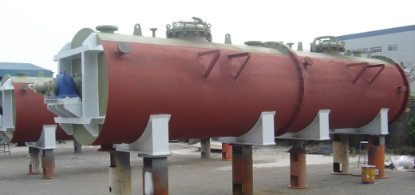
Drying and Dewatering
Drying and dewatering for removing moisture → Convection, Conduction and Radiation dryers.
Different types of dryers are: fixed-bed, rotary, tunnel, fluidized-bed, pneumatic, spouted-bed dryers
Drying allows:
reduction in the volume
inhibition of biochemical reactions
reduction of transportation costs
safe waste storage
reduction of degree of hazard
Rotary Dryer
https://www.hitemptech.com/rotary-dryers.html
Notes:
Shredded light fraction are pre-dried to decrease the weight

Slide 27
Material Recovery Systems
Materials specifications
Principle recoverable materials in MSW: Paper, cardboard, plastics, glass, ferrous metals, and nonferrous metals
Decision to recover any or all of the materials is usually based on local considerations and an economic evaluation.
In assessing the economics of materials recovery, the materials specifications will be a critical consideration.
Processing and Recovery Systems
Process flow sheets must be developed for the removal of the desired components and for processing combustible materials.

Slide 28
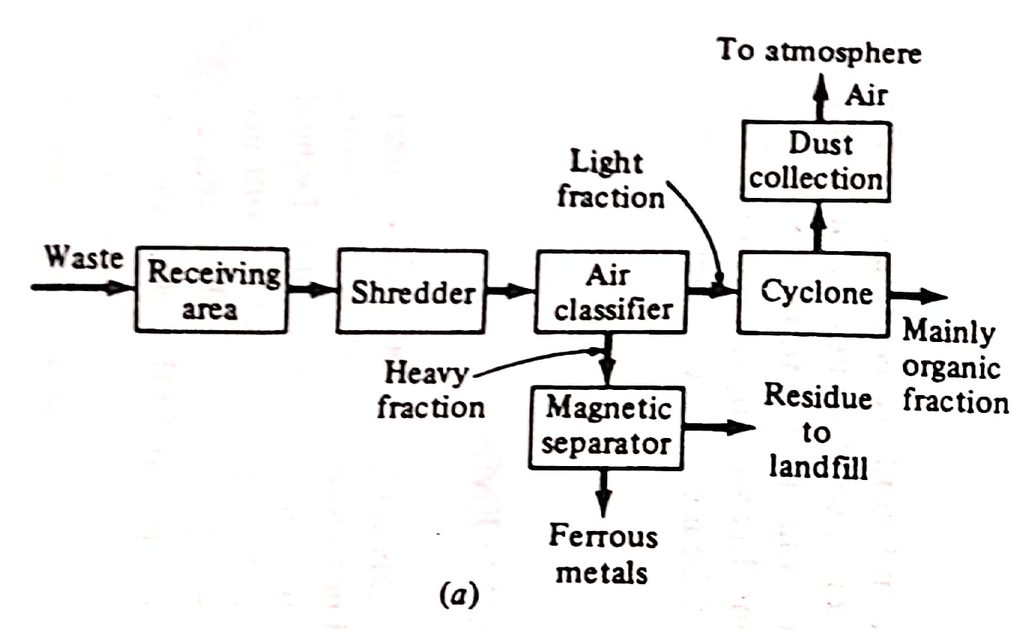
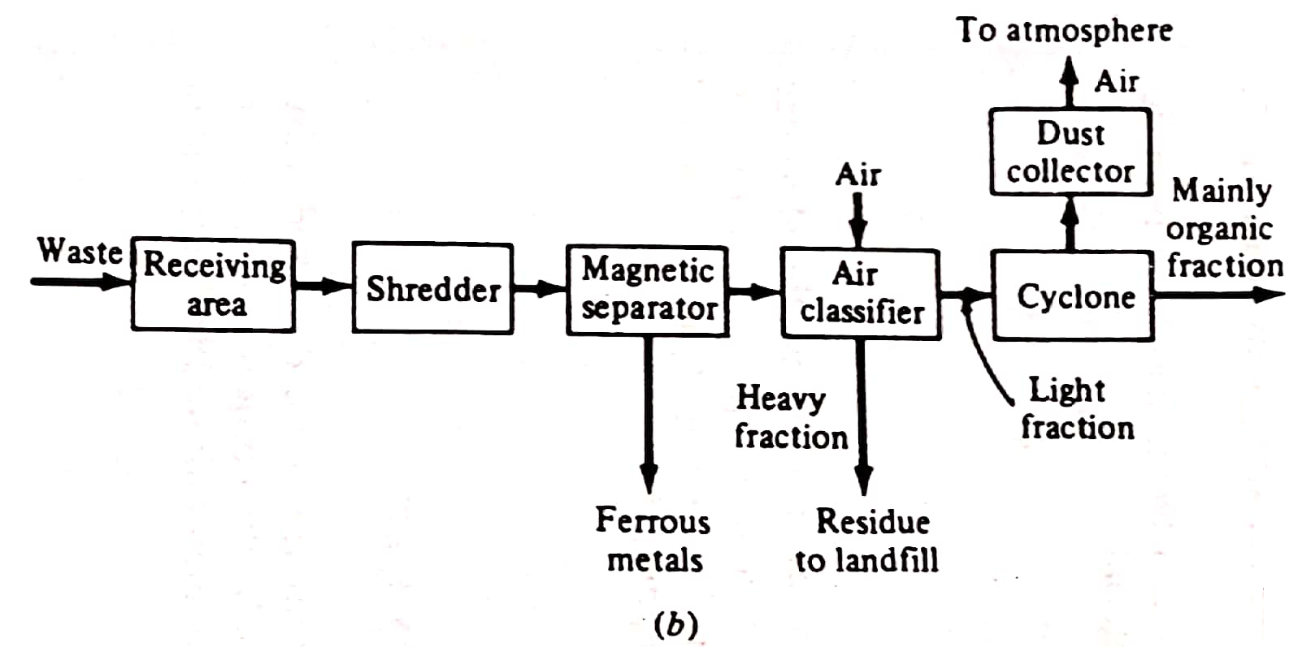
Flow Sheets for Recovery of Waste Components
Conventional flow sheets
Notes:
The second method is more efficient since the load on the air classifier blower is less from the absence of ferrous materials

Slide 29
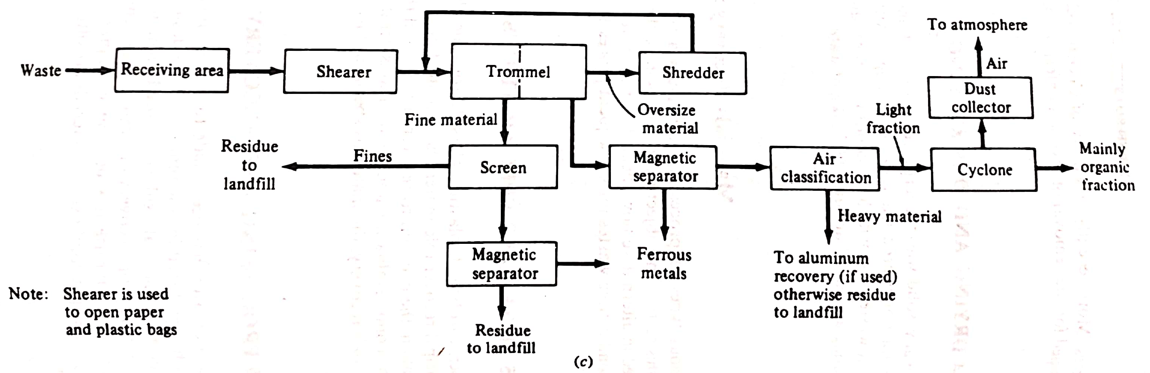
Flow Sheets for Recovery of Waste Components
Flow sheets for MSW where Trommel is used instead of shredder
Peavy, H.S., Rowe, D.R., Tchobanoglous, G., Environmental Engineering, 2013, McGraw Hill, Delhi
Notes:
Shredder is not kept before trommel since that will result in unnecessary energy utilization

Slide 30
Summary Question
Determine the break-even time for a stationary-container system and a separate transfer and transport system, for transporting wastes collected from a metropolitan area to al landfill disposal site. Assume the following cost and systems data are applicable:
Transportation costs:
Stationary-container system using an 18 m³ compactor = $20/hr
Tractor-trailer transport unit with a capacity of 120 m³ = $25/hr
Other costs:
Transfer station operating cost, including amortization = $0.40/m³
Extra cost for unloading facilities for tractor-trailer transportation unit = $0.05/m³
Other data:
Density of wastes in compactor = 325 kg/m³
Density of wastes in transport units = 150 kg/m³
Submission due by 27th September 2020

